Slide 1


Optimizing Inventory Management: A Roadmap to Efficiency
Effective inventory management is a critical component of any successful business. This presentation will explore strategies and best practices to help you streamline your inventory operations and drive continuous improvement.
by Robert Alabi

Slide 2
The Challenges of Inventory Management
Excess Stock
Stock Shortages
Carrying too much inventory can lead to high storage costs and decreased agility.
Insufficient inventory can result in lost sales and dissatisfied customers.

Slide 3



Inventory Tracking and Visibility
Automated Tracking
Centralized Visibility
Leverage barcode scanning and RFID to capture real-time inventory data.
Utilize integrated systems to provide a single source of truth for all inventory data.

Slide 4




Demand Forecasting and Planning
1
Historical Data
2
Market Trends
3
Customer Behavior
4
Predictive Analytics
Combine data from various sources to accurately forecast demand and optimize inventory levels.

Slide 5

Inventory Optimization Strategies
Safety Stock
Economic Order Quantity
Maintain appropriate buffer levels to mitigate the risk of stockouts.
Determine the optimal order size to balance costs and inventory levels.
Cycle Counting
Regularly audit inventory to ensure accuracy and identify discrepancies.

Slide 6




Warehouse and Distribution Optimization
Layout Design
Optimize storage and picking zones to improve efficiency.
Automation
Leverage technology like robotics and autonomous vehicles to streamline operations.
Transportation
Optimize routing and delivery schedules to reduce costs and improve customer service.

Slide 7

Integrating Inventory with Supply Chain
Supplier Collaboration
Cross-functional Alignment
Foster strong partnerships to ensure timely and accurate inventory replenishment.
Align inventory management with overall supply chain strategy and goals.
1
2
3
Logistics Optimization
Coordinate transportation and distribution to minimize lead times and costs.

Slide 8
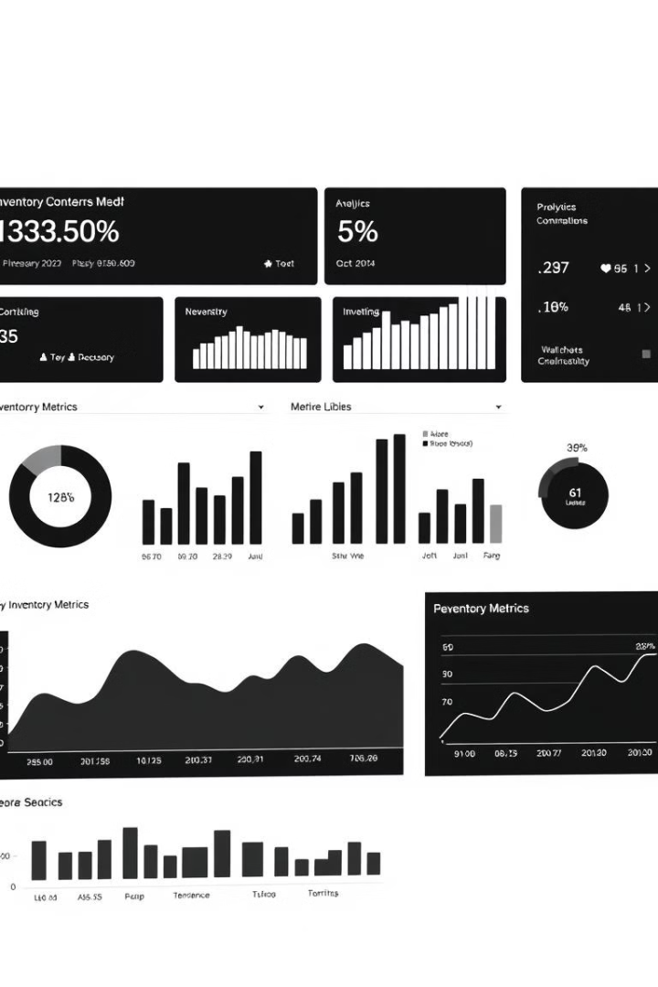
Leveraging Data and Analytics for Continuous Improvement
95%
Inventory Accuracy
25%
Inventory Turnover Increase
$500K
Annual Cost Savings
By implementing the strategies discussed, you can achieve measurable improvements in inventory performance, cost reduction, and overall operational efficiency.

